Slide 1
Matplotlib
Plotting graphs in Python

Slide 2
Matplotlib Import and Version
import matplotlib
print(matplotlib.__version__)

Slide 3
Matplotlib Pyplot
import matplotlib.pyplot as plt
import numpy as np
xpoints = np.array([0, 6])
ypoints = np.array([0, 250])
plt.plot(xpoints, ypoints)
plt.show()

Slide 4
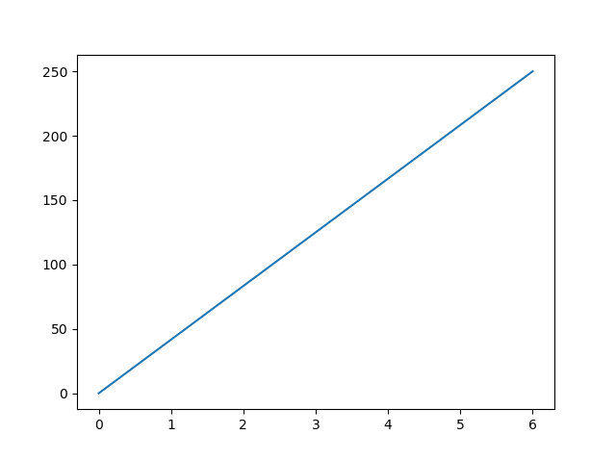
Matplotlib Plyplot Example

Slide 5
Plotting x and y points
The plot() function is used to draw points (markers) in a diagram.
By default, the plot() function draws a line from point to point.
The function takes parameters for specifying points in the diagram.
Parameter 1 is an array containing the points on the x-axis.
Parameter 2 is an array containing the points on the y-axis

Slide 6

Draw a line in a diagram from position (1, 3) to position (8, 10):
import matplotlib.pyplot as plt
import numpy as np
xpoints = np.array([1, 8])
ypoints = np.array([3, 10])
plt.plot(xpoints, ypoints)
plt.show()

Slide 7
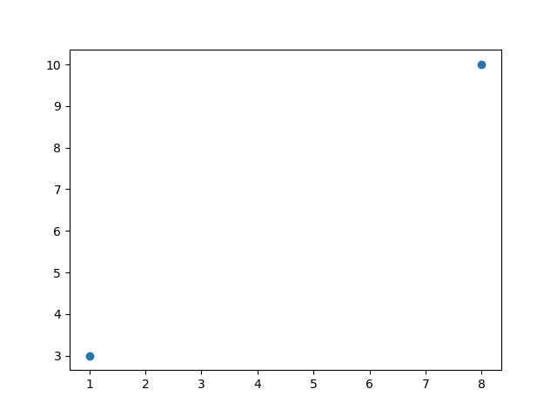
Plotting Without Line
import matplotlib.pyplot as plt
import numpy as np
xpoints = np.array([1, 8])
ypoints = np.array([3, 10])
plt.plot(xpoints, ypoints, 'o')
plt.show()

Slide 8
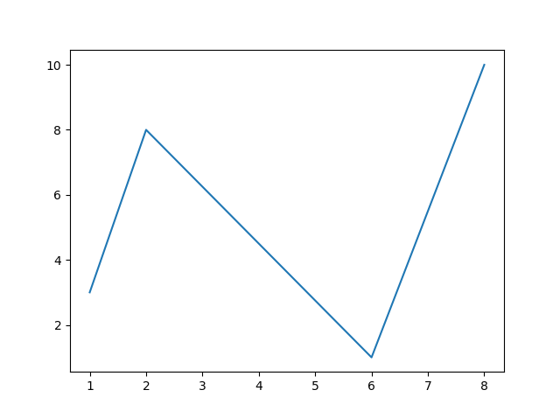
Multiple Points
import matplotlib.pyplot as plt
import numpy as np
xpoints = np.array([1, 2, 6, 8])
ypoints = np.array([3, 8, 1, 10])
plt.plot(xpoints, ypoints)
plt.show()

Slide 9
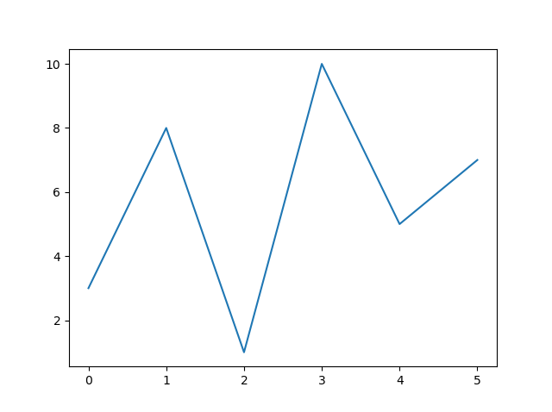
Default X-Points
import matplotlib.pyplot as plt
import numpy as np
ypoints = np.array([3, 8, 1, 10, 5, 7])
plt.plot(ypoints)
plt.show()

Slide 10
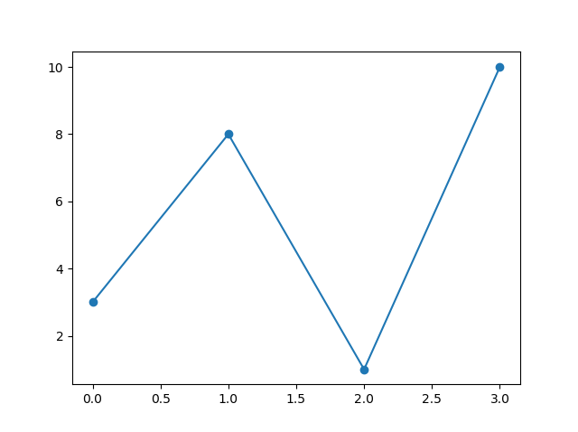
Matplotlib Markers
Mark ech point as a circle
import matplotlib.pyplot as plt
import numpy as np
ypoints = np.array([3, 8, 1, 10])
plt.plot(ypoints, marker = 'o')
plt.show()

Slide 11
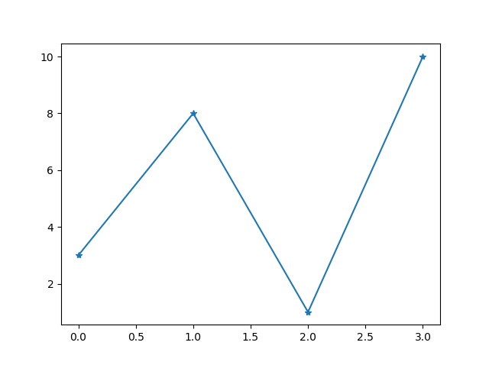
Matplotlib Markers (contd.)
Mark ech point as a star
plt.plot(ypoints, marker = '*')

Slide 12
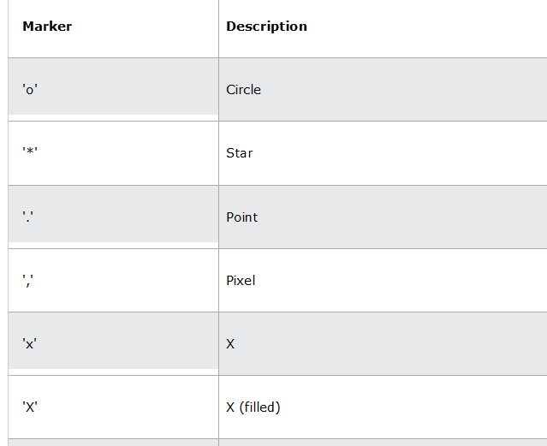

Slide 13
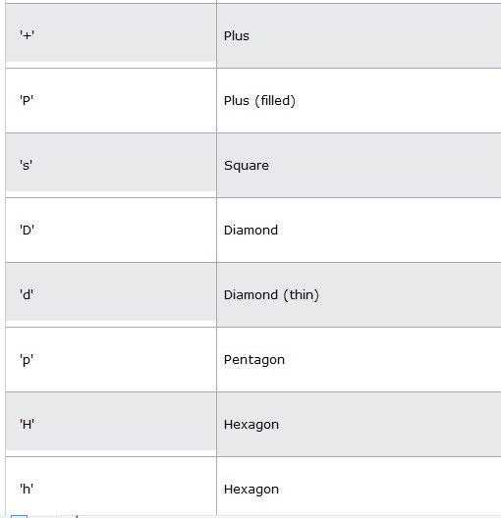

Slide 14
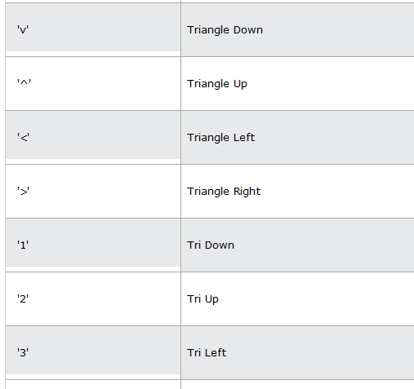

Slide 15
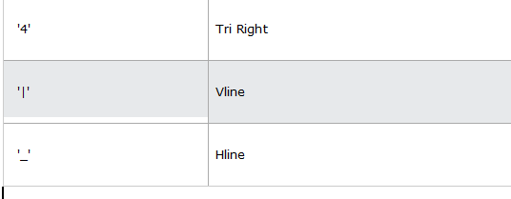
These are the different markers that can be used in different cases.

Slide 16
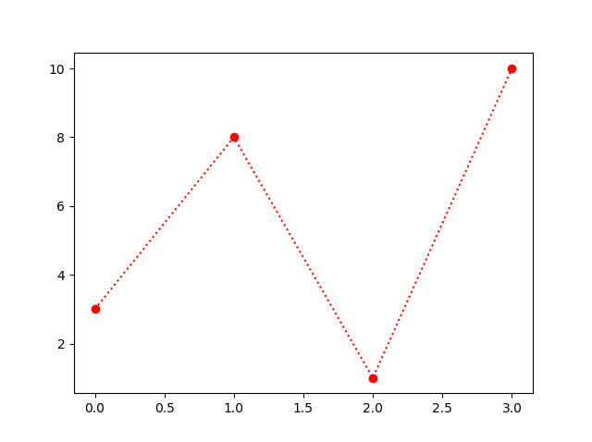
Format Strings fmt
This parameter is also called fmt, and is written with this syntax:
marker|line|color
import matplotlib.pyplot as plt
import numpy as np
ypoints = np.array([3, 8, 1, 10])
plt.plot(ypoints, 'o:r')
plt.show()

Slide 17
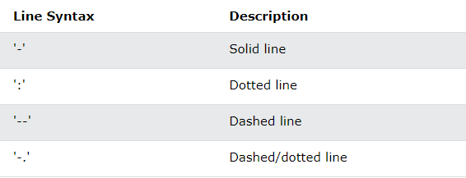
Line Reference

Slide 18
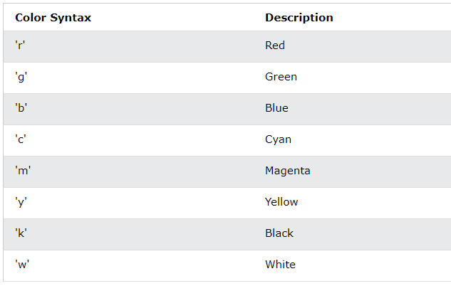
Color Reference

Slide 19
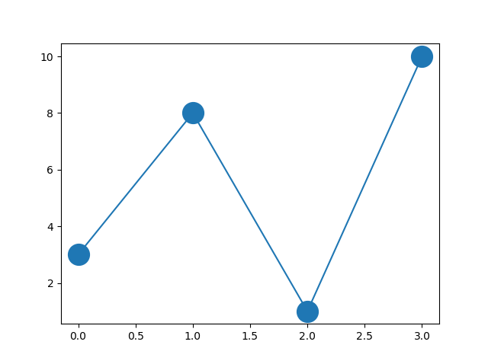
Marker Size
import matplotlib.pyplot as plt
import numpy as np
ypoints = np.array([3, 8, 1, 10])
plt.plot(ypoints, marker = 'o', ms = 20)
plt.show()

Slide 20
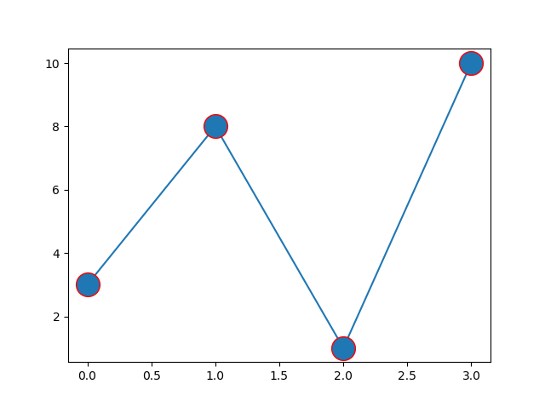
Marker Color
import matplotlib.pyplot as plt
import numpy as np
ypoints = np.array([3, 8, 1, 10])
plt.plot(ypoints, marker = 'o', ms = 20, mec = 'r')
plt.show()

Slide 21
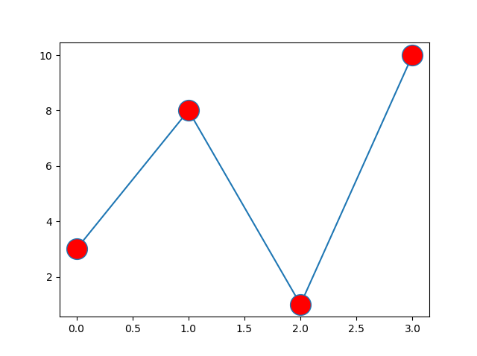
Set the FACE color to red:
import matplotlib.pyplot as plt
import numpy as np
ypoints = np.array([3, 8, 1, 10])
plt.plot(ypoints, marker = 'o', ms = 20, mfc = 'r')
plt.show()

Slide 22
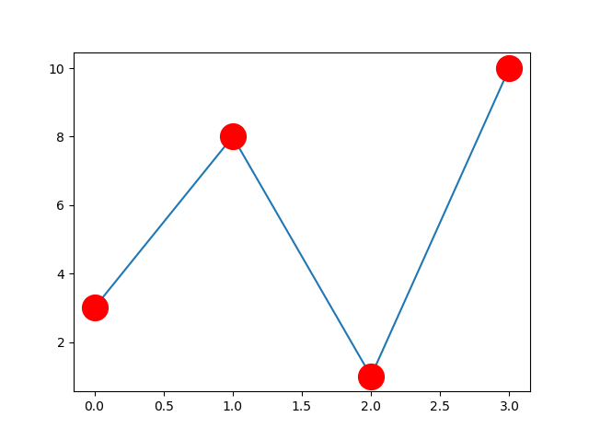
Set the color of both the edge and the face to red:
import matplotlib.pyplot as plt
import numpy as np
ypoints = np.array([3, 8, 1, 10])
plt.plot(ypoints, marker = 'o', ms = 20, mec = 'r', mfc = 'r')
plt.show()

Slide 23
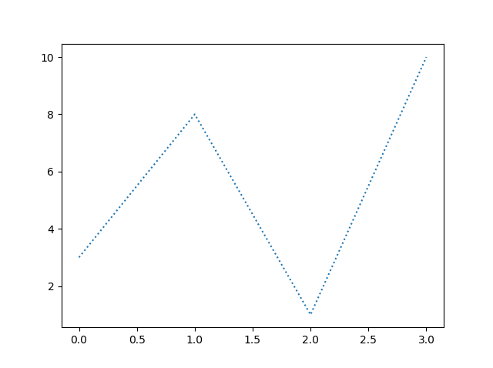
Matplotlib Line
import matplotlib.pyplot as plt
import numpy as np
ypoints = np.array([3, 8, 1, 10])
plt.plot(ypoints, linestyle = 'dotted')
plt.show()

Slide 24
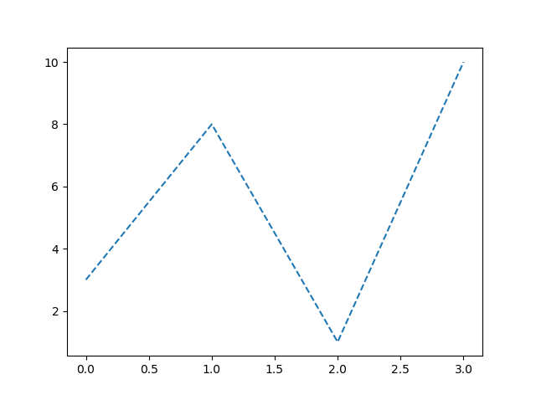
Line Style
plt.plot(ypoints, linestyle = 'dashed')

Slide 25
Line Style (contd.)
Shorter Syntax
The line style can be written in a shorter syntax:
linestyle can be written as ls.
dotted can be written as :.
dashed can be written as --.
plt.plot(ypoints, ls = ':')

Slide 26
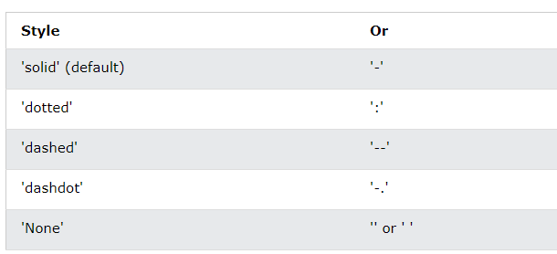
Line Style (contd.)

Slide 27
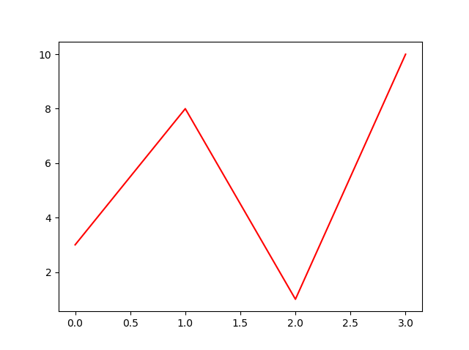
Line Color
Example
import matplotlib.pyplot as plt
import numpy as np
ypoints = np.array([3, 8, 1, 10])
plt.plot(ypoints, color = 'r')
plt.show()
Another example
...
plt.plot(ypoints, c = '#4CAF50')
...
Graph will be greenish in color

Slide 28
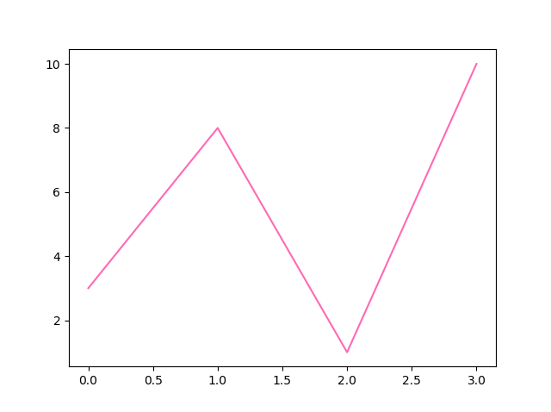
Line Color (Contd.)
...
plt.plot(ypoints, c = ‘hotpink')
...

Slide 29
Line Width
You can use the keyword argument linewidth or the shorter lw to change the width of the line.
The value is a floating number, in points:

Slide 30
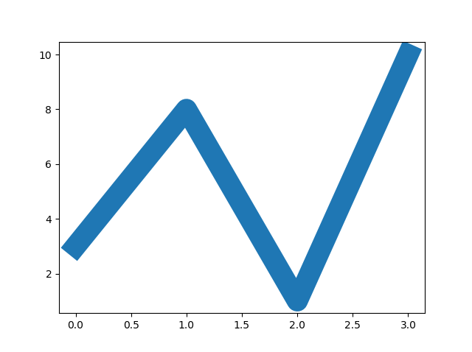
Line Width example
import matplotlib.pyplot as plt
import numpy as np
ypoints = np.array([3, 8, 1, 10])
plt.plot(ypoints, linewidth = '20.5')
plt.show()

Slide 31
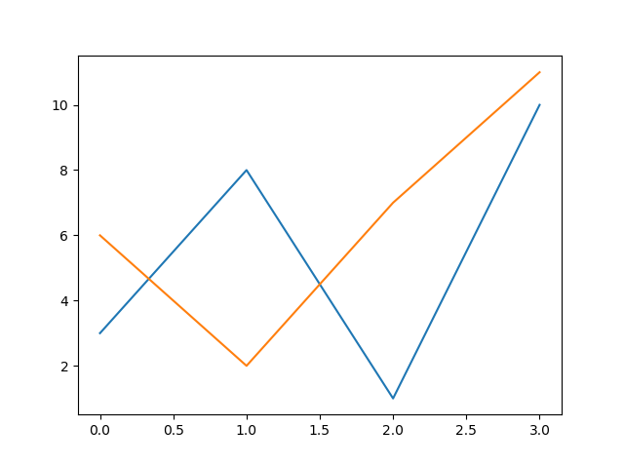
Multiple Lines
import matplotlib.pyplot as plt
import numpy as np
y1 = np.array([3, 8, 1, 10])
y2 = np.array([6, 2, 7, 11])
plt.plot(y1)
plt.plot(y2)
plt.show()

Slide 32
Matplotlib Labels and Title
import numpy as np
import matplotlib.pyplot as plt
x = np.array([80, 85, 90, 95, 100, 105, 110, 115, 120, 125])
y = np.array([240, 250, 260, 270, 280, 290, 300, 310, 320, 330])
plt.plot(x, y)
plt.xlabel("Average Pulse")
plt.ylabel("Calorie Burnage")
plt.show()

Slide 33
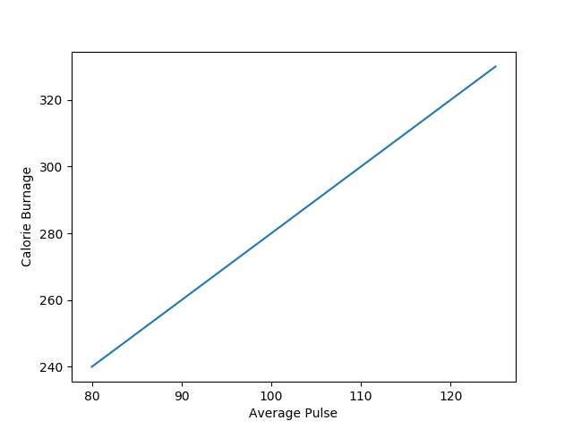

Slide 34
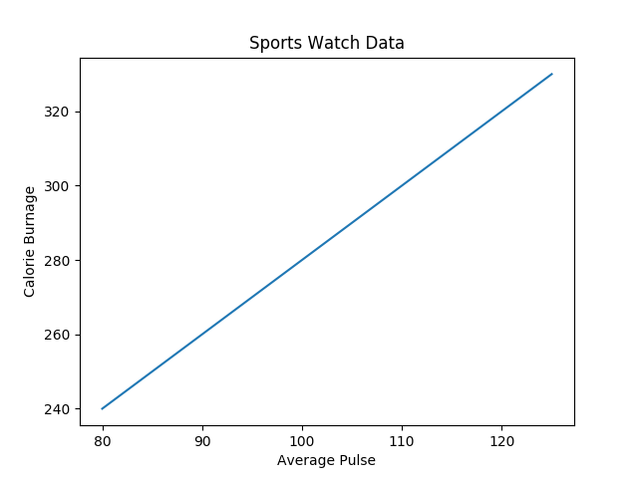
Titles and Labels
import numpy as np
import matplotlib.pyplot as plt
x = np.array([80, 85, 90, 95, 100, 105, 110, 115, 120, 125])
y = np.array([240, 250, 260, 270, 280, 290, 300, 310, 320, 330])
plt.plot(x, y)
plt.title("Sports Watch Data")
plt.xlabel("Average Pulse")
plt.ylabel("Calorie Burnage")
plt.show()

Slide 35
Set Font Properties for Title and Labels
import numpy as np
import matplotlib.pyplot as plt
x=np.array([80, 85, 90, 95, 100, 105, 110, 115, 120, 125])
y=np.array([240, 250, 260, 270, 280, 290, 300, 310, 320, 330])
font1 = {'family':'serif','color':'blue','size':20}
font2 = {'family':'serif','color':'darkred','size':15}
plt.title("Sports Watch Data", fontdict = font1)
plt.xlabel("Average Pulse", fontdict = font2)
plt.ylabel("Calorie Burnage", fontdict = font2)
plt.plot(x, y)
plt.show()

Slide 36
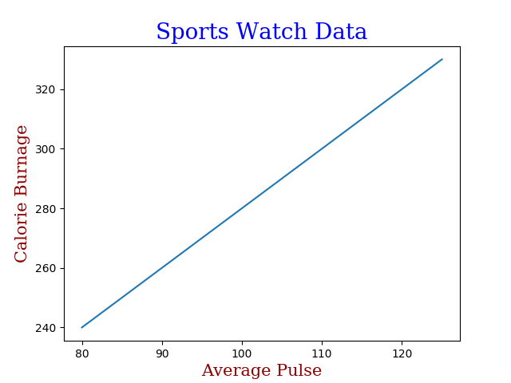

Slide 37
Position the Title
import numpy as np
import matplotlib.pyplot as plt
x = np.array([80, 85, 90, 95, 100, 105, 110, 115, 120, 125])
y = np.array([240, 250, 260, 270, 280, 290, 300, 310, 320, 330])
plt.title("Sports Watch Data", loc = 'left')
plt.xlabel("Average Pulse")
plt.ylabel("Calorie Burnage")
plt.plot(x, y)
plt.show()

Slide 38
Matplotlib Adding Grid Lines
import numpy as np
import matplotlib.pyplot as plt
x = np.array([80, 85, 90, 95, 100, 105, 110, 115, 120, 125])
y = np.array([240, 250, 260, 270, 280, 290, 300, 310, 320, 330])
plt.title("Sports Watch Data")
plt.xlabel("Average Pulse")
plt.ylabel("Calorie Burnage")
plt.plot(x, y)
plt.grid()
plt.show()

Slide 39


Slide 40
Specify Which Grid Lines to Display
import numpy as np
import matplotlib.pyplot as plt
x = np.array([80, 85, 90, 95, 100, 105, 110, 115, 120, 125])
y = np.array([240, 250, 260, 270, 280, 290, 300, 310, 320, 330])
plt.title("Sports Watch Data")
plt.xlabel("Average Pulse")
plt.ylabel("Calorie Burnage")
plt.plot(x, y)
plt.grid(axis = 'x')
plt.show()

Slide 41


Slide 42
Set Line Properties for the Grid
import numpy as np
import matplotlib.pyplot as plt
x = np.array([80, 85, 90, 95, 100, 105, 110, 115, 120, 125])
y = np.array([240, 250, 260, 270, 280, 290, 300, 310, 320, 330])
plt.title("Sports Watch Data")
plt.xlabel("Average Pulse")
plt.ylabel("Calorie Burnage")
plt.plot(x, y)
plt.grid(color = 'green', linestyle = '--', linewidth = 0.5)
plt.show()

Slide 43
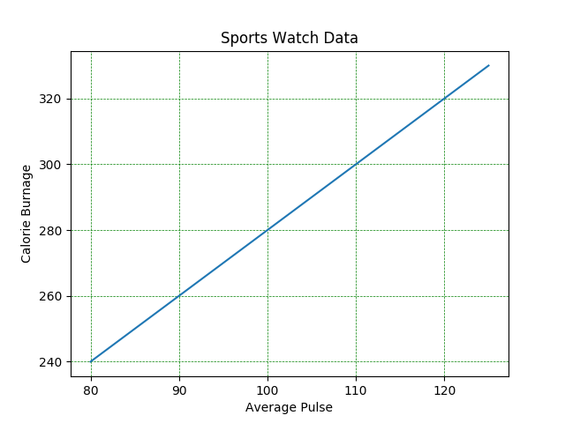

Slide 44
Matplotlib Subplot
import matplotlib.pyplot as plt
import numpy as np
#plot 1:
x = np.array([0, 1, 2, 3])
y = np.array([3, 8, 1, 10])
plt.subplot(1, 2, 1)
plt.plot(x,y)
#plot 2:
x = np.array([0, 1, 2, 3])
y = np.array([10, 20, 30, 40])
plt.subplot(1, 2, 2)
plt.plot(x,y)
plt.show()

Slide 45
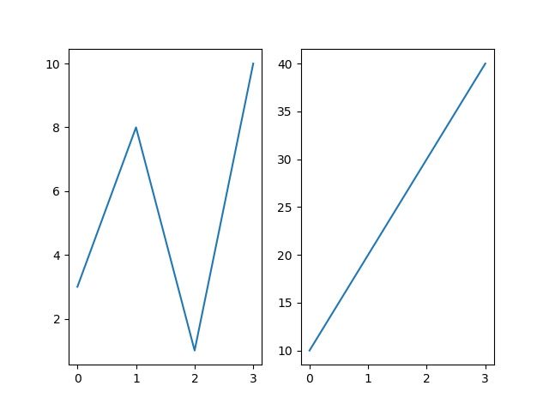

Slide 46
The subplot() Function
The subplot() function takes three arguments that describes the layout of the figure.
The layout is organized in rows and columns, which are represented by the first and second argument.
The third argument represents the index of the current plot.
plt.subplot(1, 2, 1)
#the figure has 1 row, 2 columns, and this plot is the first plot.
plt.subplot(1, 2, 2)
#the figure has 1 row, 2 columns, and this plot is the second plot.

Slide 47
Draw 2 plots on top of each other:
import matplotlib.pyplot as plt
import numpy as np
#plot 1:
x = np.array([0, 1, 2, 3])
y = np.array([3, 8, 1, 10])
plt.subplot(2, 1, 1)
plt.plot(x,y)
#plot 2:
x = np.array([0, 1, 2, 3])
y = np.array([10, 20, 30, 40])
plt.subplot(2, 1, 2)
plt.plot(x,y)
plt.show()

Slide 48
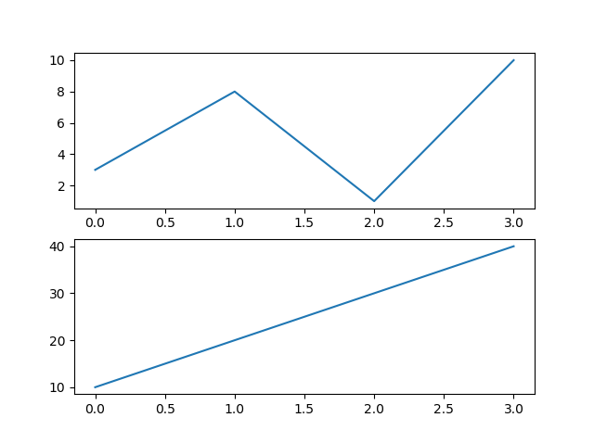

Slide 49
Drawing 6 plots:
import matplotlib.pyplot as plt
import numpy as np
x = np.array([0, 1, 2, 3])
y = np.array([3, 8, 1, 10])
plt.subplot(2, 3, 1)
plt.plot(x,y)
x = np.array([0, 1, 2, 3])
y = np.array([10, 20, 30, 40])
plt.subplot(2, 3, 2)
plt.plot(x,y)
x = np.array([0, 1, 2, 3])
y = np.array([3, 8, 1, 10])
plt.subplot(2, 3, 3)
plt.plot(x,y)
x = np.array([0, 1, 2, 3])
y = np.array([10, 20, 30, 40])
plt.subplot(2, 3, 4)
plt.plot(x,y)
x = np.array([0, 1, 2, 3])
y = np.array([3, 8, 1, 10])
plt.subplot(2, 3, 5)
plt.plot(x,y)
x = np.array([0, 1, 2, 3])
y = np.array([10, 20, 30, 40])
plt.subplot(2, 3, 6)
plt.plot(x,y)
plt.show()

Slide 50
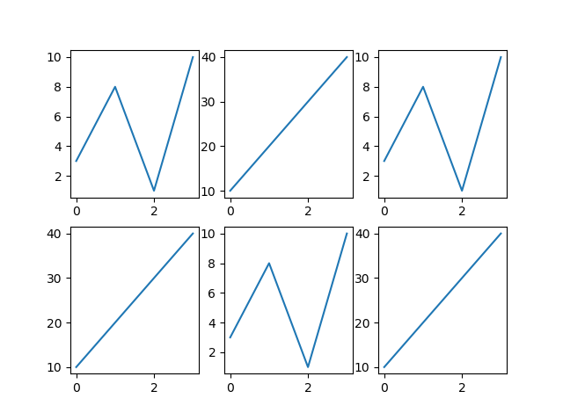

Slide 51
Add a title for the entire figure:
import matplotlib.pyplot as plt
import numpy as np
#plot 1:
x = np.array([0, 1, 2, 3])
y = np.array([3, 8, 1, 10])
plt.subplot(1, 2, 1)
plt.plot(x,y)
plt.title("SALES")
#plot 2:
x = np.array([0, 1, 2, 3])
y = np.array([10, 20, 30, 40])
plt.subplot(1, 2, 2)
plt.plot(x,y)
plt.title("INCOME")
plt.suptitle("MY SHOP")
plt.show()

Slide 52
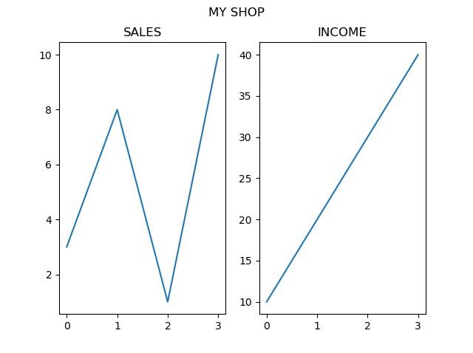

Slide 53
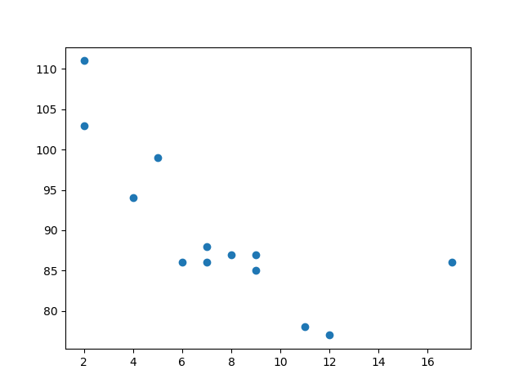
Matplotlib Scatter
import matplotlib.pyplot as plt
import numpy as np
x = np.array([5,7,8,7,2,17,2,9,4,11,12,9,6])
y = np.array([99,86,87,88,111,86,103,87,94,78,77,85,86])
plt.scatter(x, y)
plt.show()

Slide 54
Draw two plots on the same figure:
import matplotlib.pyplot as plt
import numpy as np
#day one, the age and speed of 13 cars:
x = np.array([5,7,8,7,2,17,2,9,4,11,12,9,6])
y = np.array([99,86,87,88,111,86,103,87,94,78,77,85,86])
plt.scatter(x, y)
#day two, the age and speed of 15 cars:
x = np.array([2,2,8,1,15,8,12,9,7,3,11,4,7,14,12])
y = np.array([100,105,84,105,90,99,90,95,94,100,79,112,91,80,85])
plt.scatter(x, y)
plt.show()

Slide 55
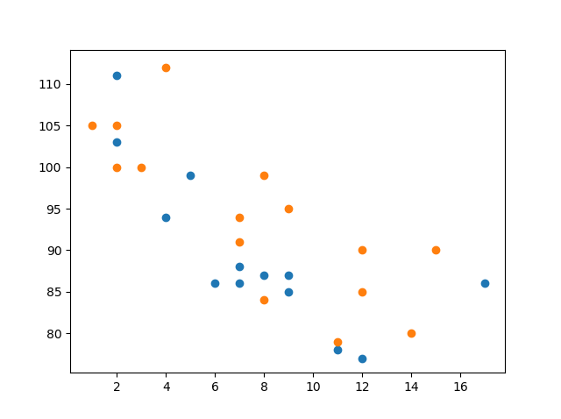

Slide 56
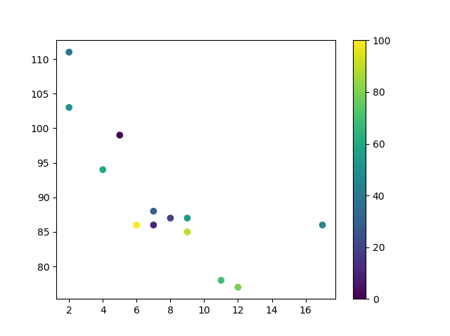
import matplotlib.pyplot as plt
import numpy as np
x = np.array([5,7,8,7,2,17,2,9,4,11,12,9,6])
y = np.array([99,86,87,88,111,86,103,87,94,78,77,85,86])
colors = np.array([0, 10, 20, 30, 40, 45, 50, 55, 60, 70, 80, 90, 100])
plt.scatter(x, y, c=colors, cmap='viridis')
plt.colorbar()
plt.show()

Slide 57
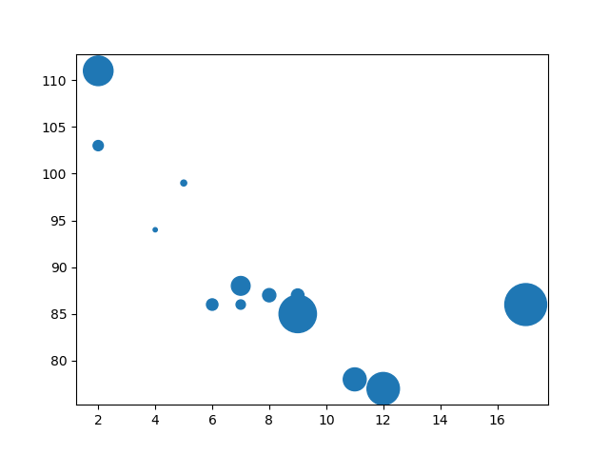
Set your own size for the markers:
import matplotlib.pyplot as plt
import numpy as np
x = np.array([5,7,8,7,2,17,2,9,4,11,12,9,6])
y = np.array([99,86,87,88,111,86,103,87,94,78,77,85,86])
sizes = np.array([20,50,100,200,500,1000,60,90,10,300,600,800,75])
plt.scatter(x, y, s=sizes)
plt.show()

Slide 58
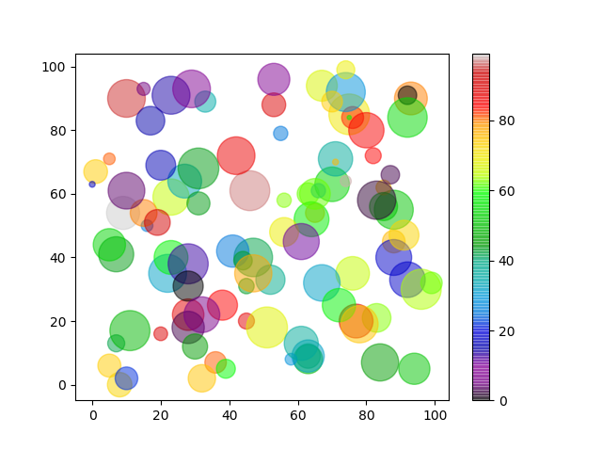
Combine Color Size and Alpha
import matplotlib.pyplot as plt
import numpy as np
x = np.random.randint(100, size=(100))
y = np.random.randint(100, size=(100))
colors = np.random.randint(100, size=(100))
sizes = 10 * np.random.randint(100, size=(100))
plt.scatter(x, y, c=colors, s=sizes, alpha=0.5, cmap='nipy_spectral')
plt.colorbar()
plt.show()

Slide 59
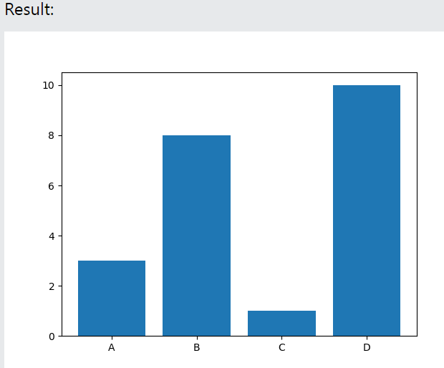
Matplotlib Bars
import matplotlib.pyplot as plt
import numpy as np
x = np.array(["A", "B", "C", "D"])
y = np.array([3, 8, 1, 10])
plt.bar(x,y)
plt.show()

Slide 60
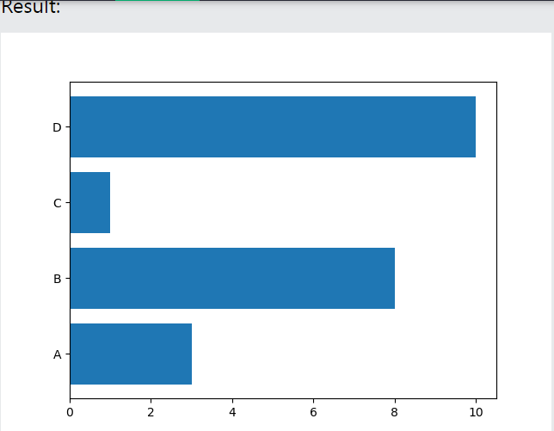
Horizontal Bars
import matplotlib.pyplot as plt
import numpy as np
x = np.array (["A", "B", "C", "D"])
y = np.array ([3, 8, 1, 10])
plt.barh(x, y)
plt.show()

Slide 61
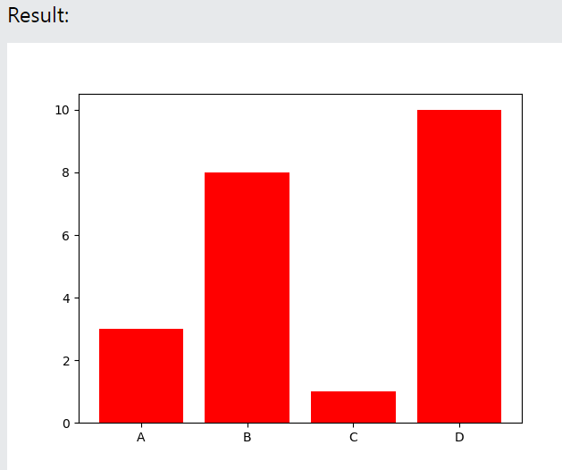
Bar Color
import matplotlib.pyplot as plt
import numpy as np
x = np.array(["A", "B", "C", "D"])
y = np.array([3, 8, 1, 10])
plt.bar(x, y, color = "red")
plt.show()

Slide 62
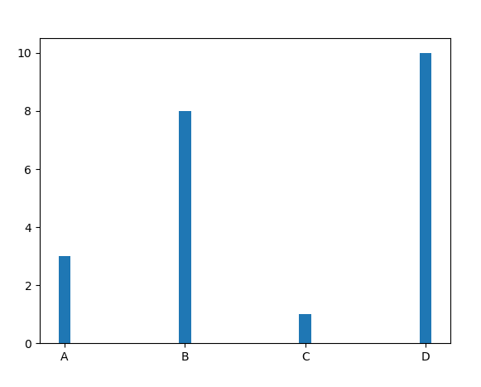
Bar Width
import matplotlib.pyplot as plt
import numpy as np
x = np.array(["A", "B", "C", "D"])
y = np.array([3, 8, 1, 10])
plt.bar(x, y, width = 0.1)
plt.show()

Slide 63
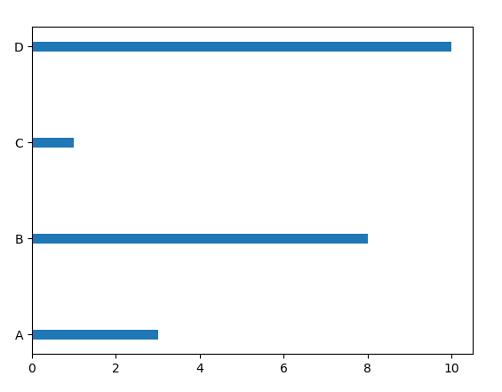
Bar Height & Width
import matplotlib.pyplot as plt
import numpy as np
x = np.array(["A", "B", "C", "D"])
y = np.array([3, 8, 1, 10])
plt.barh(x, y, height = 0.1)
plt.show()

Slide 64
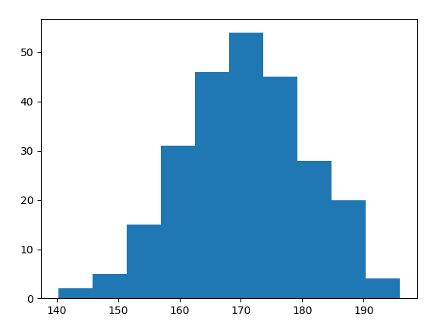
Matplotlib Histograms
A histogram is a graph showing frequency distributions.
It is a graph showing the number of observations within each given interval.
Example: Say you ask for the height of 250 people, you might end up with a histogram like this:

Slide 65
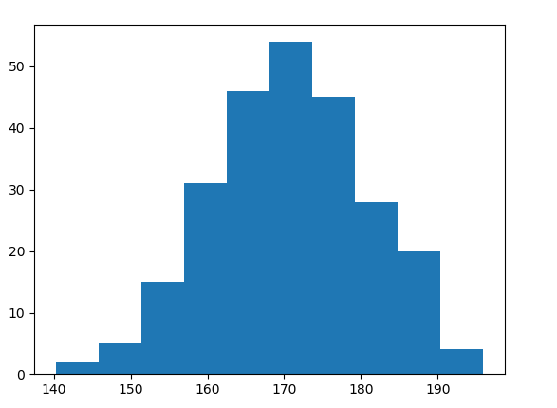
import matplotlib.pyplot as plt
import numpy as np
x = np.random.normal(170, 10, 250)
plt.hist(x)
plt.show()

Slide 66
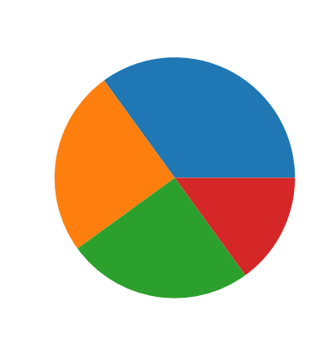
Matplotlib Pie Charts
import matplotlib.pyplot as plt
import numpy as np
y = np.array([35, 25, 25, 15])
plt.pie(y)
plt.show()

Slide 67
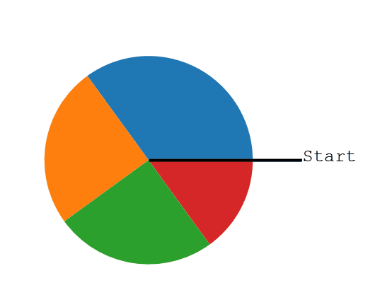
Creating Pie Charts
As you can see the pie chart draws one piece (called a wedge) for each value in the array (in this case [35, 25, 25, 15]).
By default the plotting of the first wedge starts from the x-axis and move counterclockwise:
Note: The size of each wedge is determined by comparing the value with all the other values, by using this formula:
The value divided by the sum of all values: x/sum(x)

Slide 68
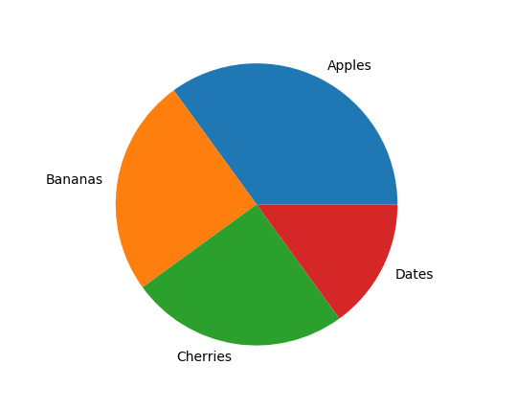
Labels
import matplotlib.pyplot as plt
import numpy as np
y = np.array([35, 25, 25, 15])
mylabels = ["Apples", "Bananas", "Cherries", "Dates"]
plt.pie(y, labels = mylabels)
plt.show()

Slide 69
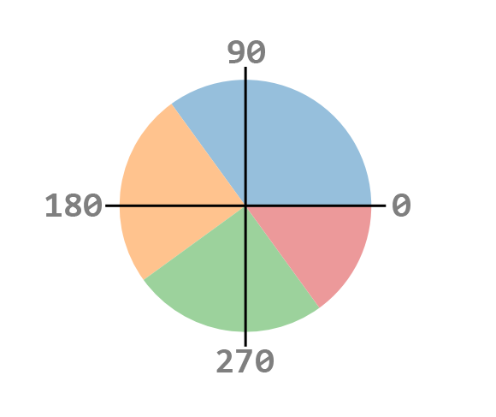
Start Angle

Slide 70
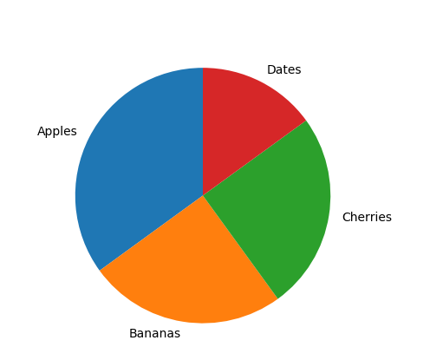
Example
import matplotlib.pyplot as plt
import numpy as np
y = np.array([35, 25, 25, 15])
mylabels = ["Apples", "Bananas", "Cherries", "Dates"]
plt.pie(y, labels = mylabels, startangle = 90)
plt.show()

Slide 71
Exploded Pie Charts
import matplotlib.pyplot as plt
import numpy as np
y = np.array([35, 25, 25, 15])
mylabels = ["Apples", "Bananas", "Cherries", "Dates"]
myexplode = [0.2, 0, 0, 0]
plt.pie(y, labels = mylabels, explode = myexplode)
plt.show()

Slide 72
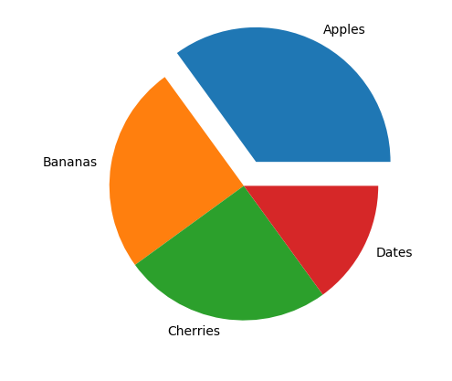

Slide 73
Shadow
import matplotlib.pyplot as plt
import numpy as np
y = np.array([35, 25, 25, 15])
mylabels = ["Apples", "Bananas", "Cherries", "Dates"]
myexplode = [0.2, 0, 0, 0]
plt.pie(y, labels = mylabels, explode = myexplode, shadow = True)
plt.show()

Slide 74


Slide 75

Colors
import matplotlib.pyplot as plt
import numpy as np
y = np.array([35, 25, 25, 15])
mylabels = ["Apples", "Bananas", "Cherries", "Dates"]
mycolors = ["black", "hotpink", "b", "#4CAF50"]
plt.pie(y, labels = mylabels, colors = mycolors)
plt.show()

